Slide 1
A 2D Layer-averaged Numerical modeling for Turbidity Currents with AMR
Wentao Gong

Slide 2
Introduction of Layer-averaged Numerical Modeling for Turbidity Currents
http://hydrolab.illinois.edu/people/parkerg/

Slide 3
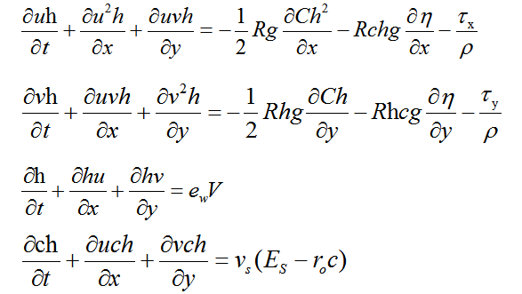

Governing equations
v_{s} = sediment fall velocity [L/T],
e_{w} = dimensionless rate of entrainment of ambient water into the turbidity current,
E_{s} = dimensionless rate of entrainment of bed sediment into the turbidity current
r_{o} = c_{b}/C > 1, where c_{b} is a near-bed suspended sediment concentration
Continuity equation
Sediment mass balance
Bed deformation

Slide 4

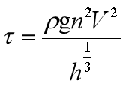

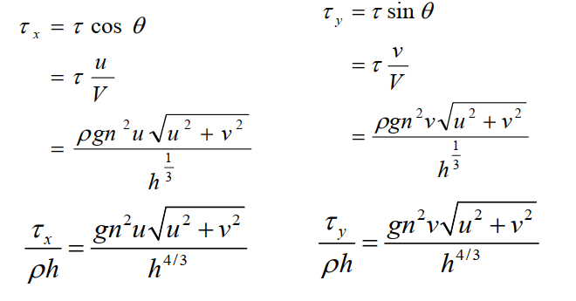
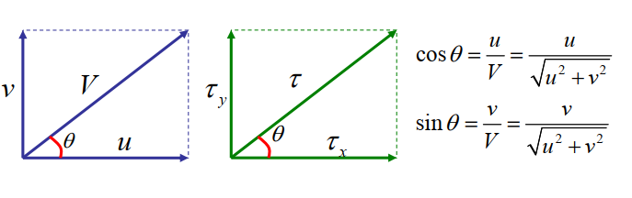
Bed shear stress
Total bed shear stress
Manning’s Roughness Formula

Slide 5
Relations
RELATION OF NEAR-BED SUSPENDED SEDIMENT CONCENTRATION TO LAYER-AVERAGED VALUE
ENTRAINMENT OF AMBIENT WATER
FROM PARKER ET AL. (1987)
ENTRAINMENT OF SEDIMENT INTO SUSPENSION
The relation is from Garcia and Parker (1991).
Parker (1982),

Slide 6
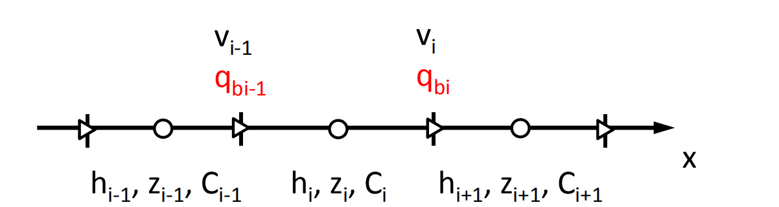
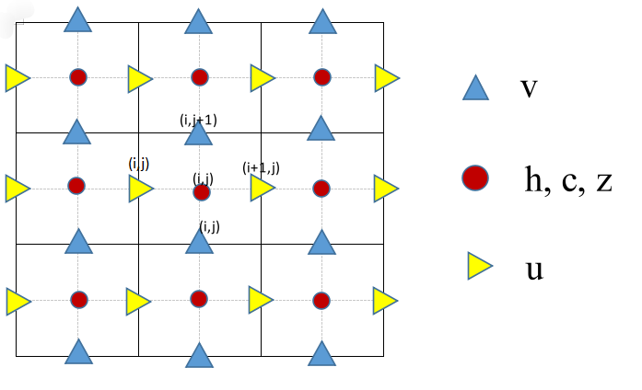
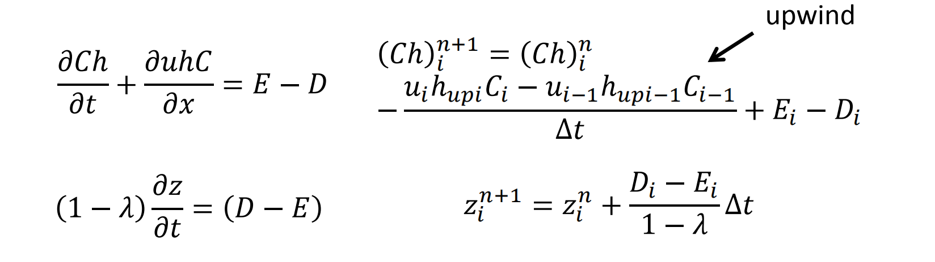
Discretization
Finite difference method
Staggered grid
Figure 1. The location of the h (thickness), c (concentration), z(elevation), u, v (flow velocities in x and y directions) on the staggered grid

Slide 7
Calculation Conditions

Slide 8
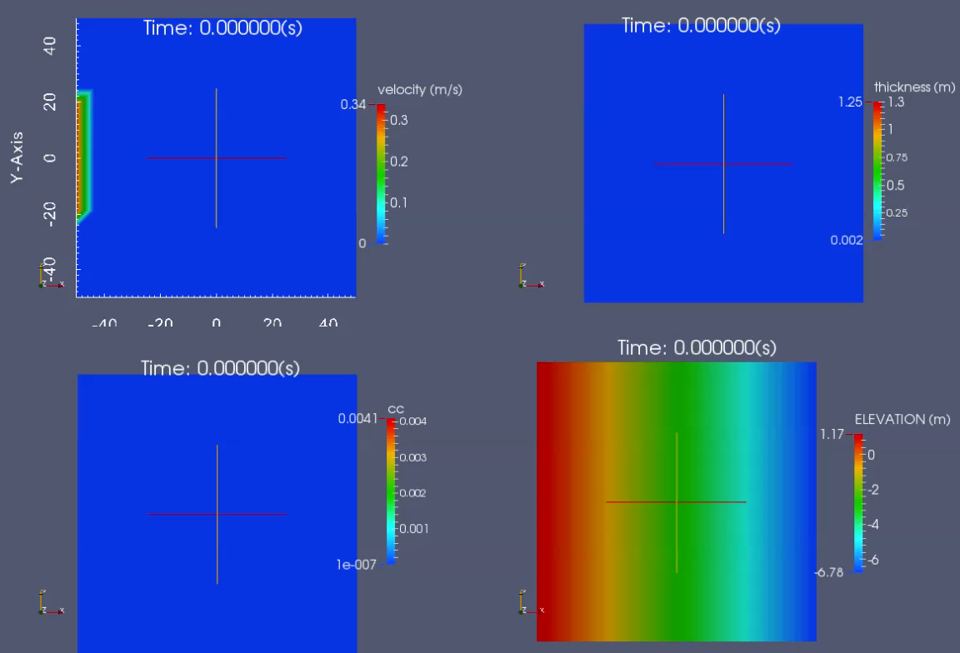
Results

Slide 9
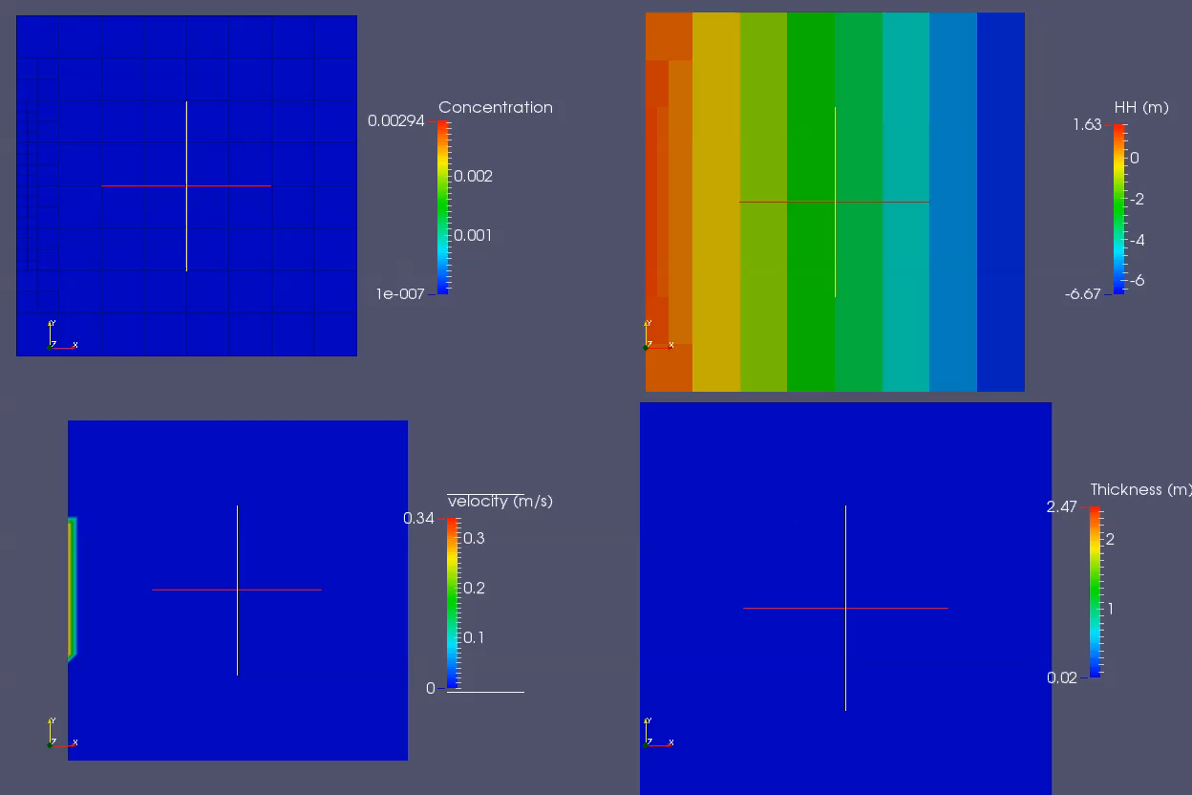
Demo (AMR)

Slide 10
Fig.2. Current velocity profiles at different time

Slide 11
Conclusions
A 2D layer-averaged numerical modeling for turbidity currents was developed form the governing equations.
A Case was tested, but there are still a lot of work on verifications and validation cases to do in the future.

Slide 12
References
http://hydrolab.illinois.edu/people/parkerg/TurbidityCurrents.html
http://hydrolab.illinois.edu/people/parkerg/
Hu, P., & Cao, Z. (2009). Fully coupled mathematical modeling of turbidity currents over erodible bed. Advances in Water Resources, 32(1), 1-15.
Hu, P. (2012). Coupled modelling of turbidity currents over erodible beds (Doctoral dissertation, Heriot-Watt University).
Iwasaki, T., & Parker, G. (2020). The role of saltwater and waves in continental shelf formation with seaward migrating clinoform. Proceedings of the National Academy of Sciences.
Parker, G., Fukushima, Y., & Pantin, H. M. (1986). Self-accelerating turbidity currents. Journal of Fluid Mechanics, 171, 145-181.
Yang, S., An, Y., & Liu, Q. (2019). A two-dimensional layer-averaged numerical model for turbidity currents. Geological Society, London, Special Publications, 477(1), 439-454

